Slide 1
Urban Data Lab Capstone Project Week 3 Status
Data 599 Mitch Harris, Ryan Koenig, Nathan Smith May 18, 2021

Slide 2
Outline
Previous Week Summary (May 10-16)
Next Week Planning (May 17-23)
Timeline Reflection
Project Details

Slide 3
Previous Week Summary
Week 2 Goals: Data and System Understanding
Select Project and Complete EDA
Understand Data Systems / Learn InfluxDB
Simulate Streaming in InfluxDB
Anomaly Detection Research
Start Anomaly Detection Modelling (secondary)

Slide 4
Goal Summaries Previous Week (May 10-16)
Select Project Data and Complete Exploratory Data Analysis - Ryan
Data available in InfluxDB is historical and limited (currently no streaming process)
EDA completed on the limited data available
Additional work supporting UDL with parsing data to be uploaded and streamed
EDA of additional data is ongoing
Still in progress and a few days behind schedule

Slide 5
Goal Summaries Previous Week (May 10-16)
Understand Data Systems and Learn InfluxDB - All
Discussions with UDL on SkySpark and understanding how data will be streamed in
Time spent working with InfluxDB and Telegraf as part of EDA and parsing
Getting Docker working with InfluxDB/Telegraf to allow local testing
On track

Slide 6
Task Summaries Previous Week (May 10-16)
Simulate Streaming in InfluxDB - Nate
Build a simple template to simulate offline streaming detection
Various potential streaming frameworks looked at
Simple coding/tests of options complete to understand viability
Will be moving forward with building framework for the selected option next week
On track

Slide 7
Task Summaries Previous Week (May 10-16)
Anomaly Detection Research (and start testing) - Mitch
Initial table of various algorithms/packages
Tested several of the methods on generic data (not UDL data)
Also reviewed various anomaly detection system approach
Selected a short-list to start testing on project data next week
On track

Slide 8
Individual Contributions Previous Week (May 10-16)
Nate: Project Management, Learn InfluxDB, Simulate Streaming in InfluxDB, Assist with Parsing, Docker
Mitch: Anomaly Detection Research, Docker
Ryan: EDA, Learn InfluxDB, Data Parsing, Docker

Slide 9
Challenges Previous Week (May 10-16)
Getting Data
No method to access additional data until late in the week
The method is time consuming (manual csv downloads)
Data Parsing to Support Streaming into InfluxDB
~4 person days went into this not in the schedule (appears to now be complete)
Streaming Anomaly Detection Methods with InfluxDB
No good examples of this being done and there are no obvious methods to use
Had to test/code multiple methods

Slide 10
Client Meetings Previous Week (May 10-16)
Monday Technical Project Meeting
Use of InfluxDB/Telegraf
Access details (SkySpark)
Discussion on supporting data parsing
Thursday Sprint Planning
Discuss data parsing and EDA issues
Plan for next week tasks

Slide 11
Next Week Planning
Week 3 Goals: Anomaly Detection Model
Data Cleaning/Feature Processing for Anomaly Detection Pipeline
Test Short-Listed Anomaly Detection Methods
Build Streaming Framework for Anomaly Detection Model with InfluxDB
Meet with Domain Experts
Start Reviewing Azure (secondary)

Slide 12
Individual Tasks Next Week (May 17-23)
Nate: Project Management, Build Streaming Framework, Review Azure (secondary)
Mitch: Builds Anomaly Detection Models
Ryan: Complete EDA, Support Anomaly Detection Modelling with focus on Cleaning/Feature Pipeline and Model Performance Review

Slide 13
Challenges Next Week (May 17-23)
Still Finishing EDA
Impacts the ability to start testing various anomaly detection methods
Framework for Streaming Anomaly Detection
With no clear framework choice, there is risk that we have not selected an ideal approach
Anomaly Detection Methods
There are a lot! Hopefully, the methods selected are reasonable approaches
Meeting with domain experts late in the week could change direction of work

Slide 14
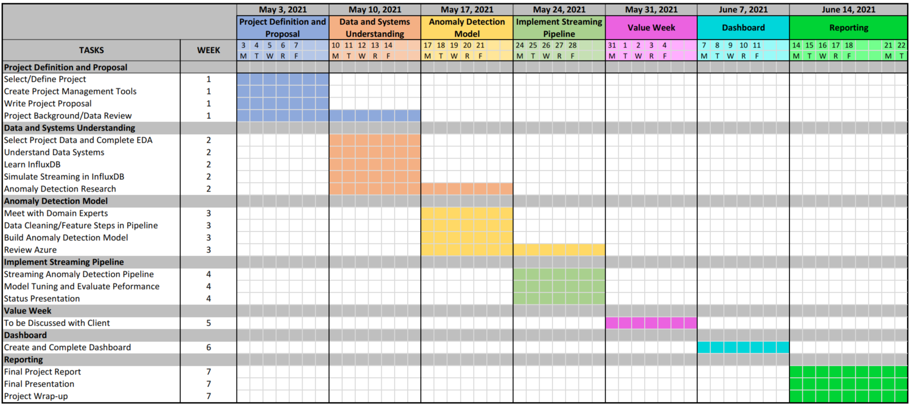
Timeline Reflection

Slide 15
Schedule Timeline Reflection
Week 1:
Complete
Week 2:
EDA slightly behind
Otherwise on track
Week | Goal
1 | Project Definitional and Proposal
2 | Data and System Understanding
3 | Anomaly Detection Model
4 | Implement Streaming Pipeline
5 | Value Week
6 | Dashboard
7 | Reporting

Slide 16
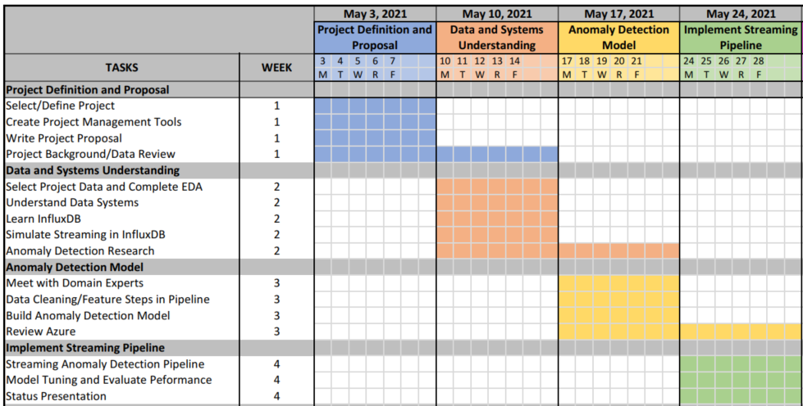


Schedule Timeline Reflection

Slide 17
Impacts to Scope Timeline Reflection
Slightly behind but not yet concerned:
Week 2 was research/understanding
Week 3 is testing/building
Week 4 is implementing
Week 5 is a value add/buffer week

Slide 18
Impacts to Scope Timeline Reflection
Week 3 will have an impact on the schedule – ready to implement in Week 4 or not
Week 5 (Value Week) can act as a buffer as needed
General note that even though helping UDL implement data streaming to InfluxDB was not part of the schedule, it provided a better understanding and ultimately needed to be done. UDL does not view this as wasted time.

Slide 19
Project Details
Streaming Detection Frameworks
Anomaly Detection Agorithms

Slide 20


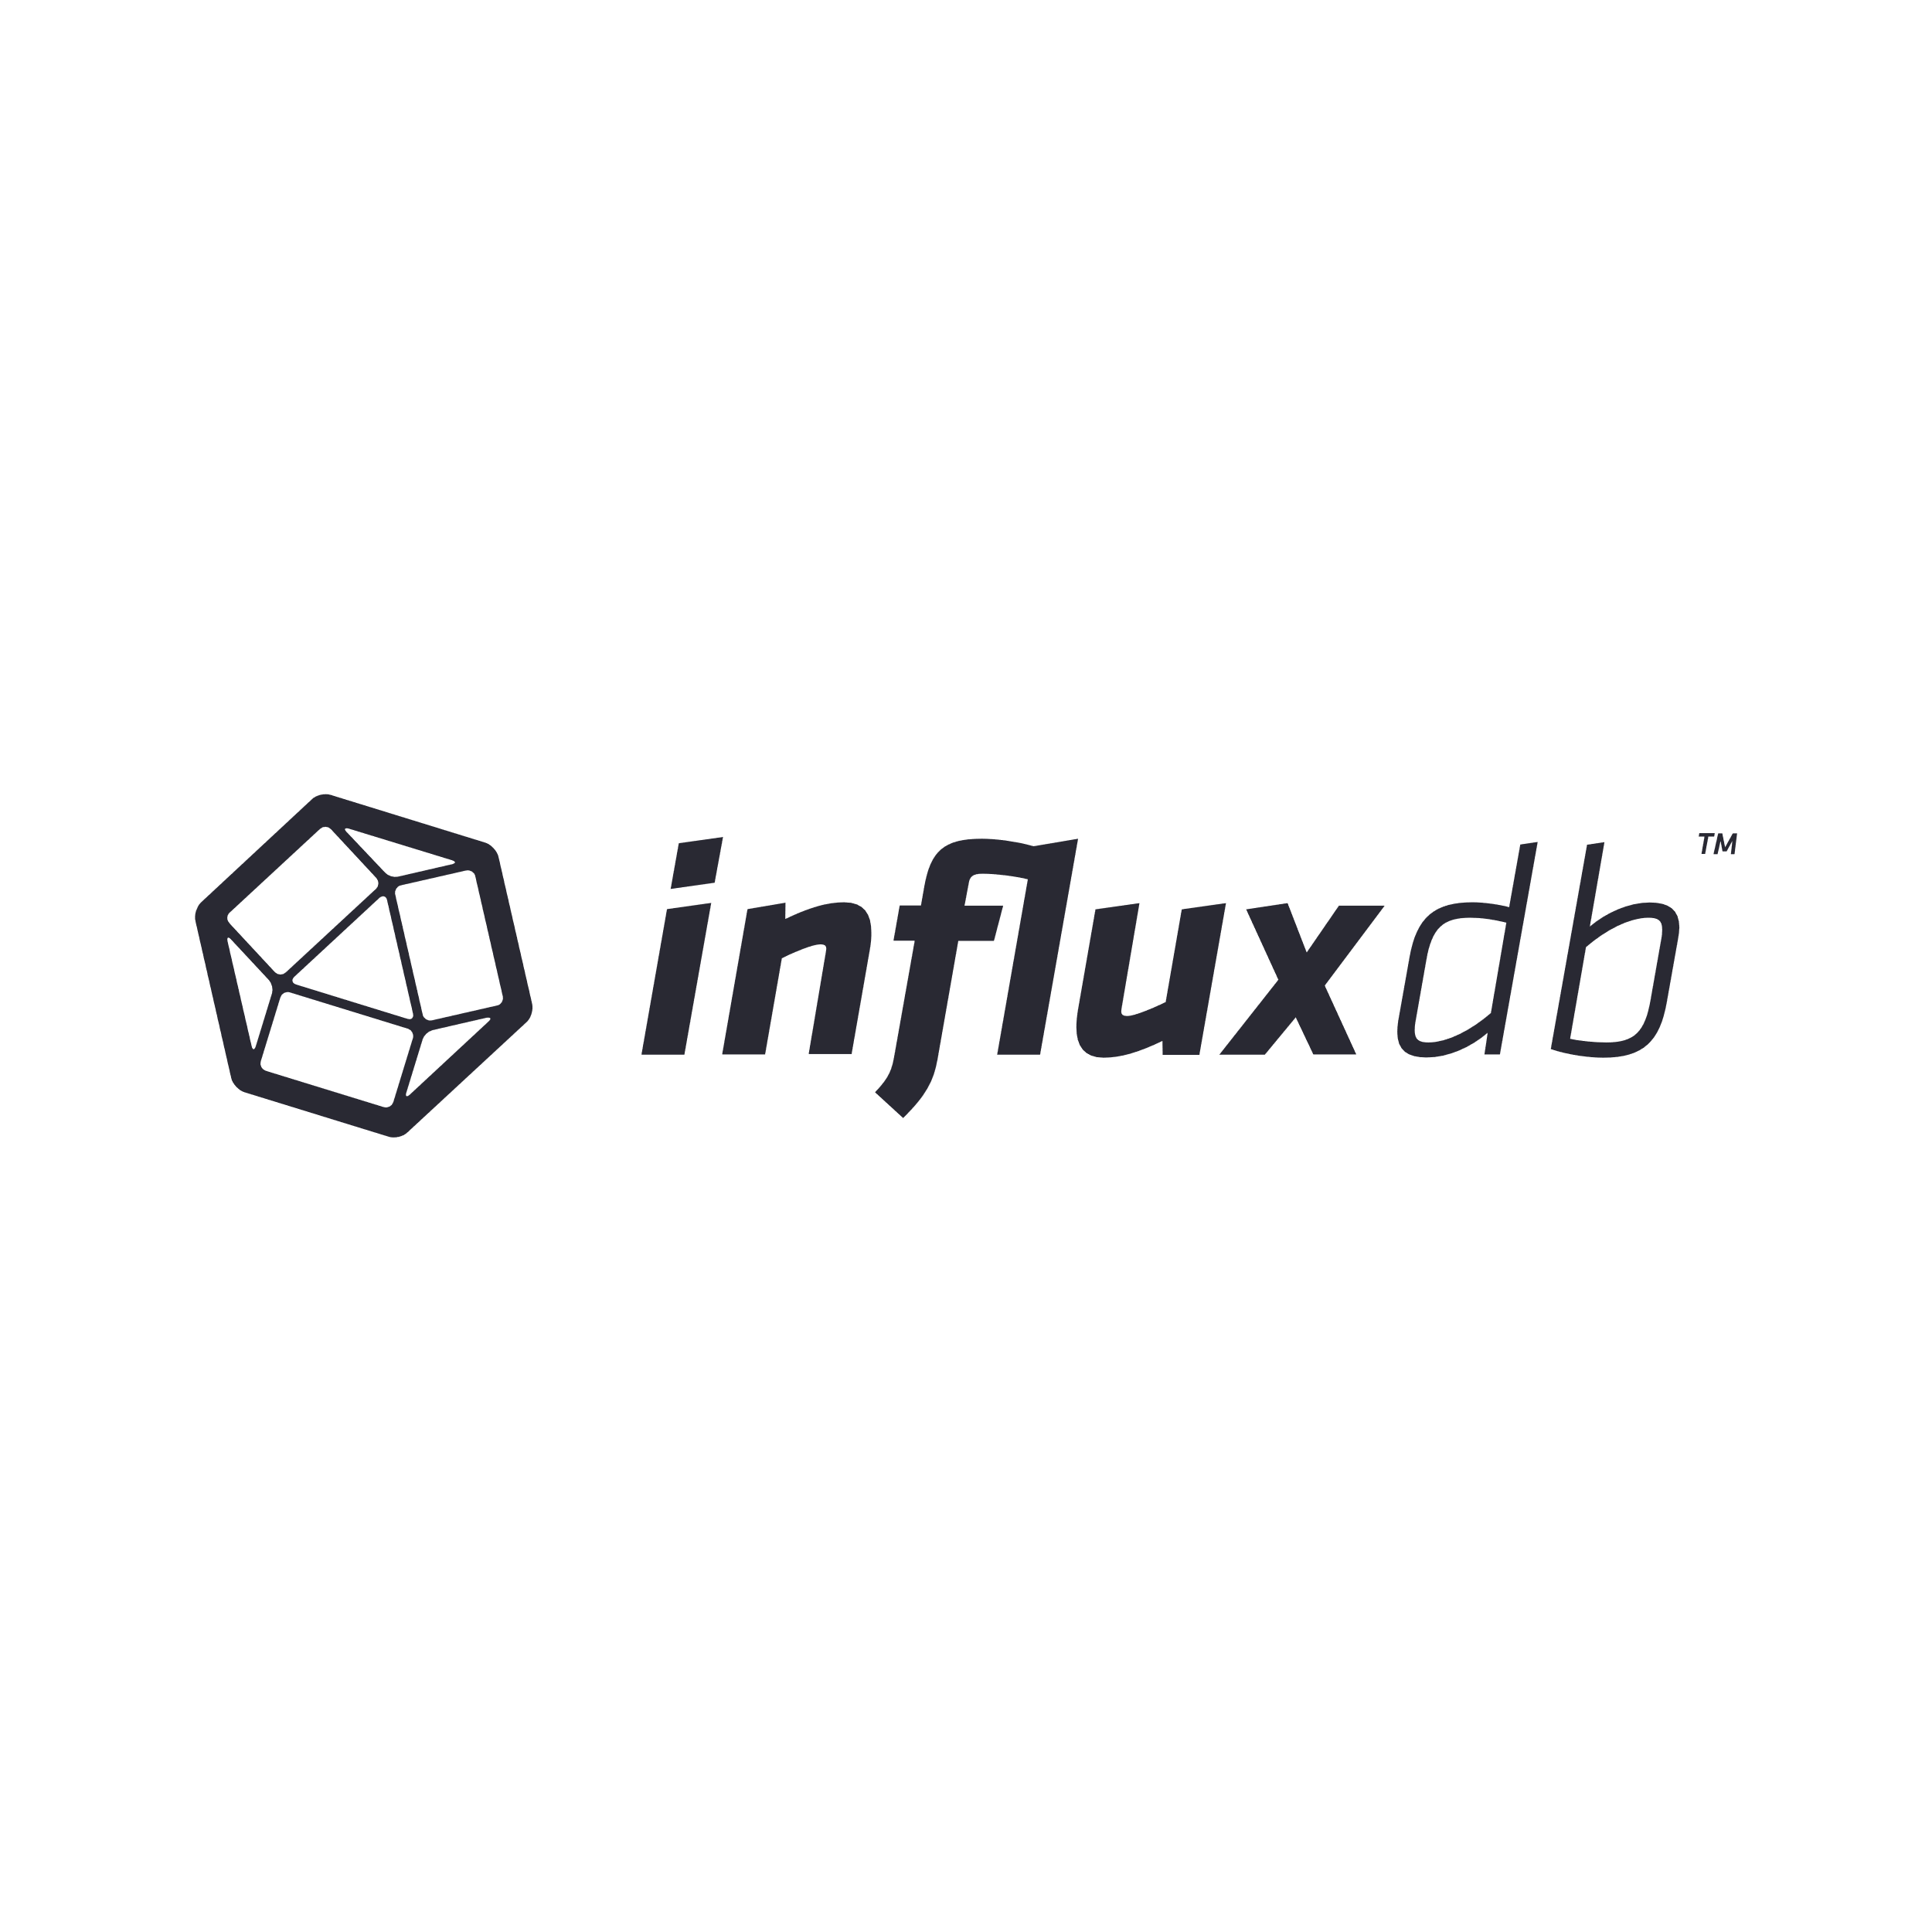
Streaming Detection Frameworks Project Details
Anomaly Detection on Read-in w/ Telegraf
Pros
Detect before the database
Telegraf is likely the fastest option
Cons
Requires a Telegraf plug-in that runs a python program, no good examples found online
Variations
Telegraf continuously runs a Python that sends data directly to InfluxDB
Not planning on currently pursuing this due current uncertainty with Telegraf which could cause issues in implementation
Raw
Parsed
Detected

Slide 21
Streaming Detection Frameworks Project Details
Anomaly Detection with Flux Tasks
Pros
Post-processing allows pulling more than incoming data
Cons
Likely slower than method #1 for detection
Requires setting up an API or getting Telgraf to pick-up http post
Not planning on currently pursuing this due to current uncertainty with Telegraf or additional effort in setting up API
Raw
Parsed
Detected
API
or

Slide 22
Streaming Detection Frameworks Project Details
Anomaly Detection with InfluxDB-Python and RxPy/Cron Task
Pros
No need for Telegraf running an external program
Read-in is separated from anomaly detection
Cons
Anomaly detection is potentially slower
Requires running a continuous Python program
Using this is our current plan as it doesn’t require Telegraf and should be general enough that it could be later implemented with Telegraf
Raw
Parsed
Detected

Slide 23

Streaming Detection Frameworks Project Details
Full Potential Framework
Anomaly detection model are trained and parameters stored
Anomaly detector only reads latest points and uses stored parameters
Run Daily/Weekly to Update Model
Model Parameters Stored
Raw
Parsed
Detected
Continuous Read/Detect/Write

Slide 24
Anomaly Detection Algorithms Project Details

Slide 25
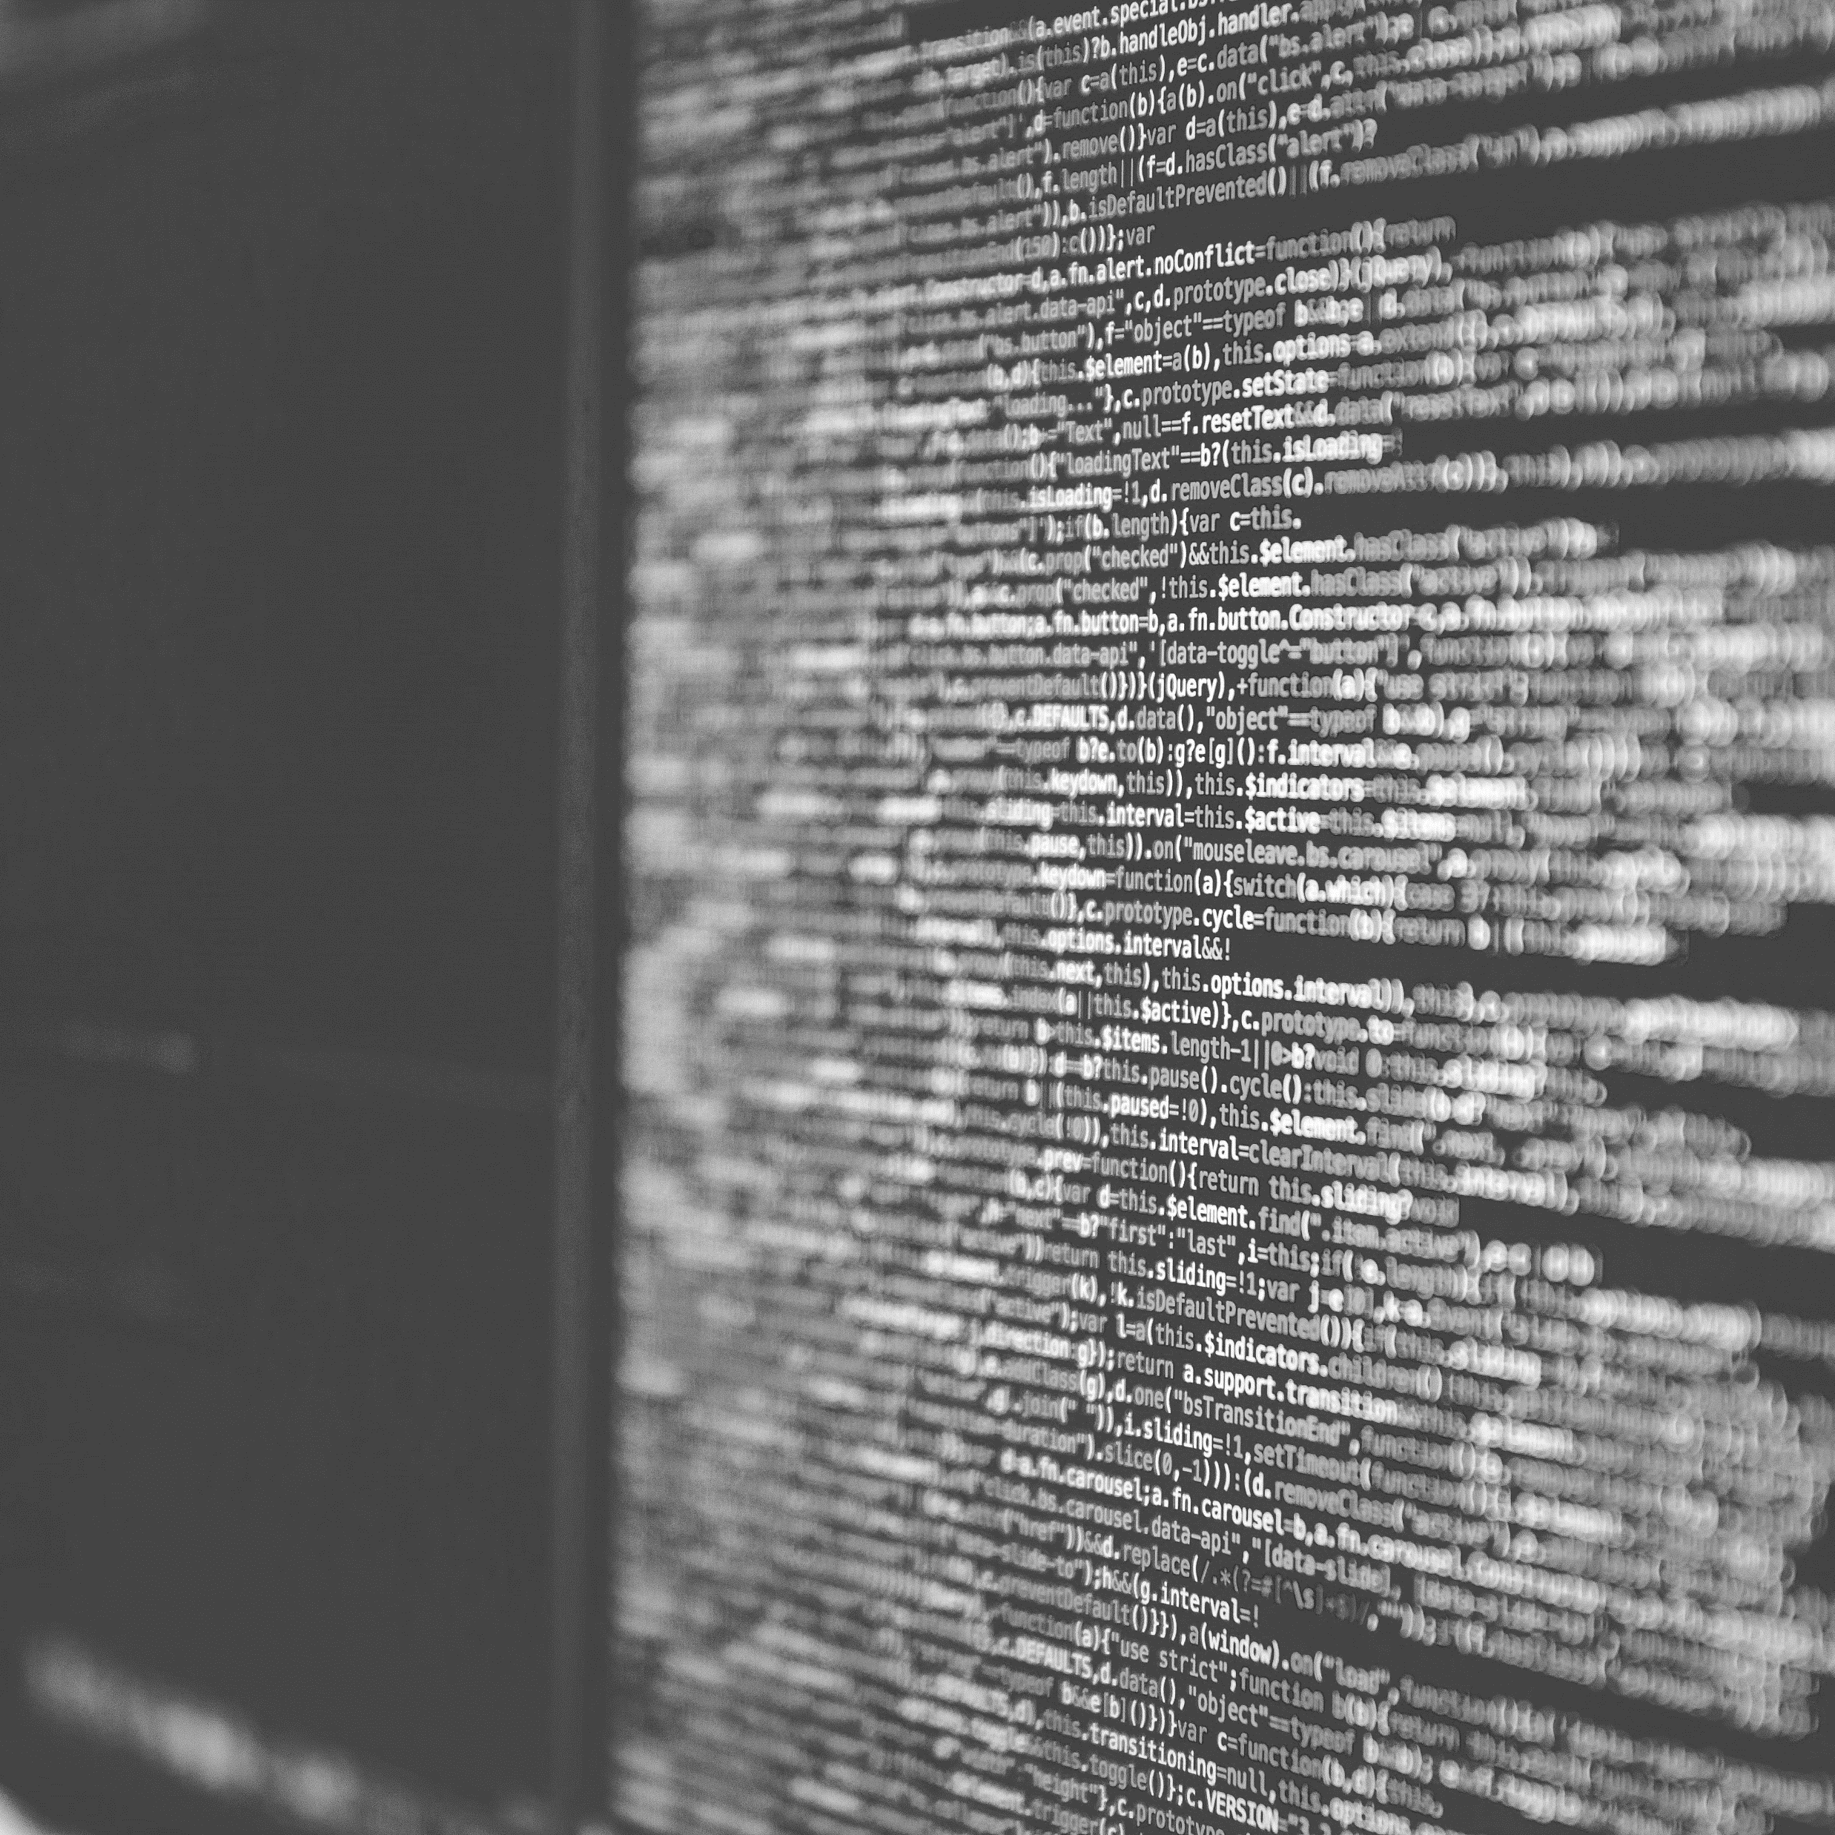
Q&A
Mitch Harris
Ryan Koenig
Nathan Smith
Photo by Markus Spiske on Unsplash

